Slide 1
DAY 2 - Getting Started
Yii2 Introduction

Slide 2

Yii2 Introduction
High performance,
component-based PHP framework for rapidly developing modern Web applications
Mean "simple and evolutionary" in Chinese. It can also be thought of as an acronym for Yes It Is!
Like most PHP frameworks, Yii implements the MVC (Model-View-Controller) architectural pattern

Slide 3
Setup Environment
Day 2 - Getting Started

Slide 4




Preparation

Slide 5
Installing Yii2 Application via Terminal
Open Terminal or Command Prompt
Find the BEST location to store Yii2 project
In your command prompt, enter
composer global require "fxp/composer-asset-plugin:^1.2.0"
4) Then enter this to download Yii2 package
composer create-project --prefer-dist yiisoft/yii2-app-basic myfirstyii2
Testing folder ke2**composer create-project --prefer-dist yiisoft/yii2-app-basic mysecondyii2

Slide 6
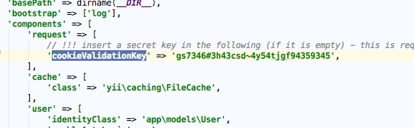
Installing Yii2 Application from an Archive File
Tip:
***ctrl + p = utk carian dlm folder dlm subline**
Open link www.yiiframework.com/download/
Click Yii 2 with basic application template to start download
Extract basic folder to the BEST location to store Yii2 project
Rename basic folder to myfirstyii2 (apa2 nama je) cth mybasictemplateyii
Locate web.php and fill in config and fill in cookieValidationKey (taip apa2 je aksara)

Slide 7
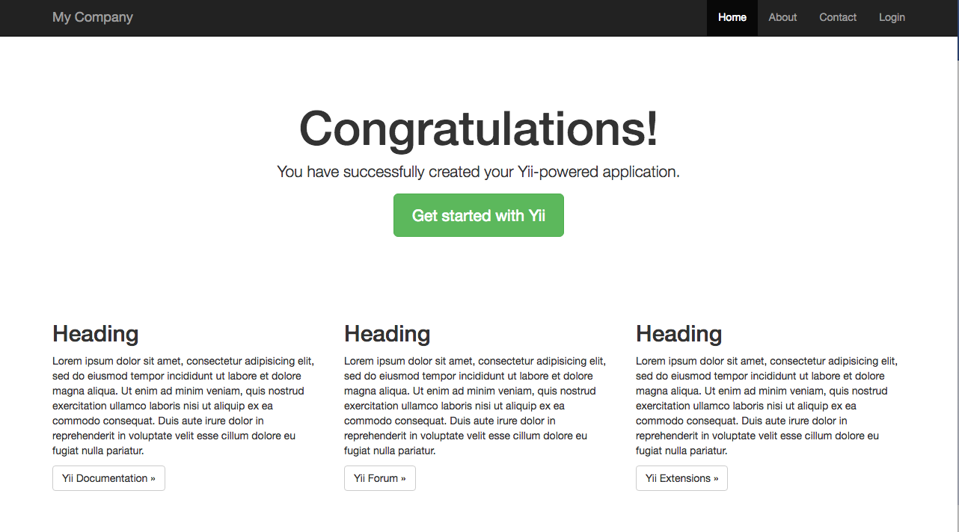
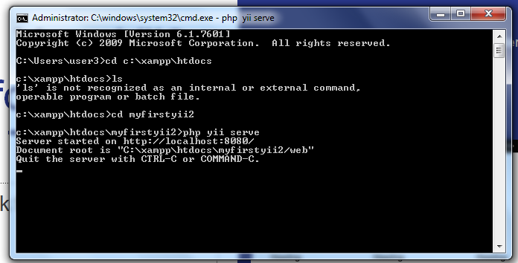
Run Your Yii2 App for the First Time
Type “ cd-your project destination-enter
Enter the command below and Run
php yii serve
Open http://localhost:8080 on browser

Slide 8

Setup Database
Create database name “myfirstyii2”

Slide 9
Configuration
Day 2 - Getting Started

Slide 10
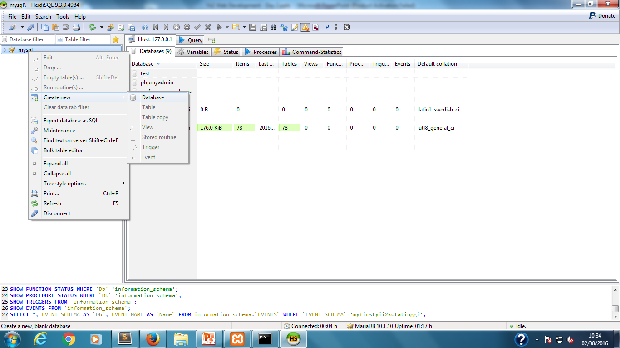
Open -> Heidi SQL -> new → letak nama file mysql → right click kat root → creat new database

Slide 11
Configure Database Connection
Open db.php inside config folder (dlm subline)
Modify the code as follow
return [
'class' => 'yii\db\Connection', nama sama dlm heidisql
'dsn' => 'mysql:host=127.0.0.1;dbname=myfirstyii2',
'username' => 'root',
'password' => '',
'charset' => 'utf8',
];

Slide 12
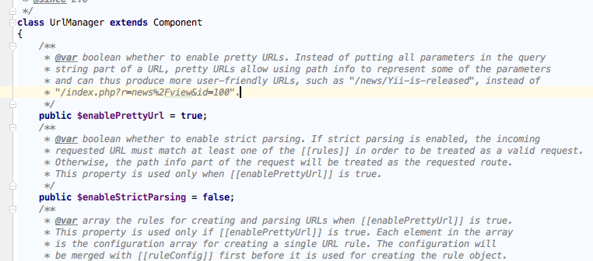
Enable prettyURL
Open UrlManager.php inside /vendor/yiisoft/yii2/web. Change the false to true
Buka dlm subline

Slide 13
Create .htaccess
This will allow for prettyURL to work. Create .htaccess inside web folder.
<IfModule mod_rewrite.c>
RewriteEngine on
# If a directory or a file exists, use it directly
RewriteCond %{REQUEST_FILENAME} !-f
RewriteCond %{REQUEST_FILENAME} !-d
# Otherwise forward it to index.php
RewriteRule . index.php
</IfModule>
Dlm subline → cari web → copy coding → save as nama .htaccess

Slide 14
Application Component
Day 2 - Getting Started

Slide 15
YII HAS 2 MAIN COMPONENT
BOOTSTRAP
An application component will only be instantiated when it is being accessed the first time. If it is not accessed at all during a request, it will not be instantiated. Sometimes, however, you may want to instantiate an application component for every request, even if it is not explicitly accessed. To put it simple, the component would immediately start whenever the application started
CORE COMPONENTS
A set of core application components with fixed IDs and default configurations. For example, the request component is used to collect information about a user request and resolve it into a route; the db component represents a database connection through which you can perform database queries. It is with help of these core application components that Yii applications are able to handle user requests.
Benda asas
Notes:
Bootstrap adalah

Slide 16
Yii2 MVC Concept
MVC = Model View Controller
Provide Data
model
controller
View (paparan)
Business Data, Rules, Logic
Analyze, CRUD, validate, queries
Interface, Presenting Data
Calling for Data
Request
(Http)
user
Response (JSON, XML)
Human or computer Client

Slide 17
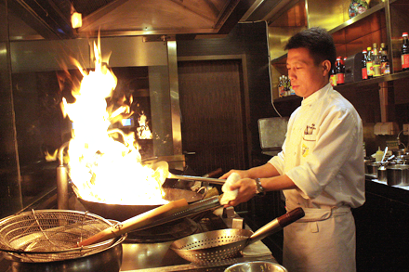

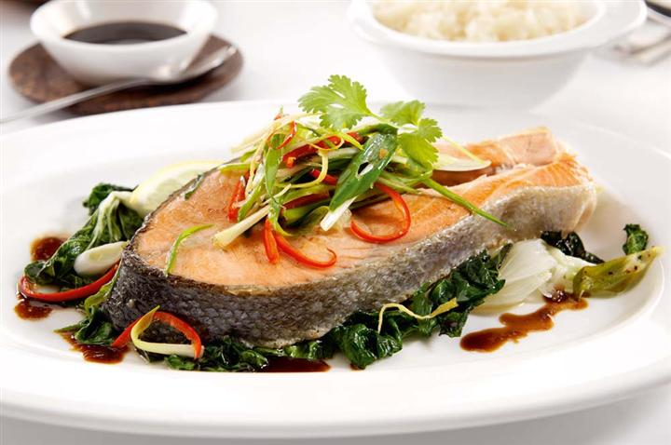

Yii2 MVC Analogy
Makes the finishing touch before presenting to View
Give the requested data (Food)
model
controller
view
Calling for Data (Telling what menu to make)
user
Response (Customer get what it order)
Request (Order a menu)

Slide 18
Model
Attribute
Validation Rules
Create a new php file inside Model folder and name it Book.
Object representing business data, rules and logic
(database)

Slide 19
Attributes
Models represent business data in terms of attributes. Create model Book.php inside folder model. Class must be the same as the file name. In this case, class Book representing Book.php file
<?php
namespace app\models;
use yii\base\Model;
class Book extends Model{
function attributeLabels()
{
return ["bookname" => "Introduction to Yii2 Programming", //Assign Attribute
"publisher" => "Pearson", //Assign Attribute
"edition" => "Ninth Edition", //Assign Attribute
"author" => "Y.Daniel Liang", //Assign Attribute
"price" => 118.00]; //Assign Attribute
}
}
?>
Notes:
Defining Attributes

Slide 20
Validation Rules
Validate the input before making an action to the database
public function rules()
{
return [
[['bookname', 'publisher', 'author', 'price'], 'required']
];
}

Slide 21
View
Creating View
Create a new php file inside Model folder and name it Book.
Presenting code in User Interface

Slide 22
Creating View
Create folder name book in folder view. And create list.php in folder book
<?php
use yii\helpers\Html;
use yii\helpers\Url;
$this->title = 'Book';
$this->params['breadcrumbs'][] = $this->title;;
$books = $bookModel->attributeLabels();
?>
<div class="site-list">
<ul>
<li><?php echo $books['bookname']; ?></li>
<li><?php echo $books['publisher']; ?></li>
<li><?php echo $books['edition']; ?></li>
<li><?php echo $books['author']; ?></li>
<li><?php echo $books['price']; ?></li>
</ul>
</div>

Slide 23
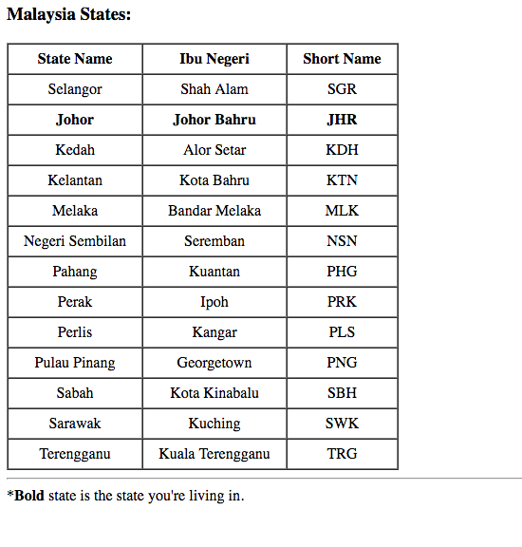
Exercise
Create as follow using Model and View

